Slide 1
Dublin Senior Living
Community Meeting
April 21, 2022
Notes:
Good evening everyone, welcome to the community meeting for the Dublin Senior Living project.

Slide 2
Meeting Agenda
7:00-7:05 Arrival and Introductions
7:05-7:10 Overview of the City’s Development Application Review Process
7:10-7:20 Project Overview
7:20 Questions & Answers
By 8:00 Closing and Thank You
Notes:
This is our agenda for this evening. We will start with introductions, then I will provide an overview of the city’s development application review process, followed by an overview of the project and we will open the meeting up to Q&A.

Slide 3
Development Review Process
South Bay Partners, LLC. (Applicant)
Site is owned by HHH Investment Company
Application Submittal/Review
Planned Development Rezoning
Site Development Review Permit
Application requires Planning Commission recommendation to City Council for final action
Notes:
The applicant for this project is South Bay Partners, with the property owner being HHH Investment Company. The applicant has submitted an application to development a licensed residential care facility, with the requested approvals including a Planned Development Rezoning as the property is subject to Planned Development Zoning that does not currently permit the proposed project, as well as a Site Development Review Permit. The application requires Planning Commission recommendation to City Council for final action.

Slide 4
Project Location – 5751 Arnold Road
Notes:
The project site is bordered to the south by an existing office building and Central Parkway. To the west is Arnold Road, with a residential neighborhood located further west. To the east are corporate office buildings and Hacienda Drive, and to the north are commercial and office uses and Gleason Drive further north. The project vicinity includes a mix of commercial, office, residential (single-family and multifamily), institutional, and civic uses. The site is currently developed with a parking lot, landscaping and a graded pad for what was to be a future office building.

Slide 5
Proposed Project
Licensed Residential Care Facility for Elderly
152 units, including 114 assisted living units and 38 memory care units
174 beds total
17,644 square feet of private open space, including 6,187 square feet for memory care courtyard and 11,457 square feet for assisting living courtyard
43 existing trees to be preserved, 107 new trees to be planted

Slide 6
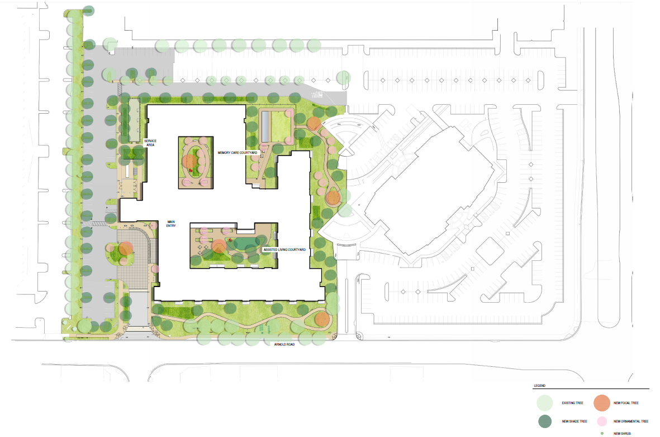
Proposed Project – Site/Landscape Plan
Notes:
This is the proposed site/landscape plan for the project. As you can see, the right side of the site plan illustrates the existing office building and parking area that the project is adjacent to. So this here is the main driveway that provides access to Arnold Road and to the main entrance of the building. Parking is provided along the northern and eastern property lines of the project. A generous landscape buffer and walkways surround the building, with interior courtyards provided for the assisted living and memory care residents.

Slide 7
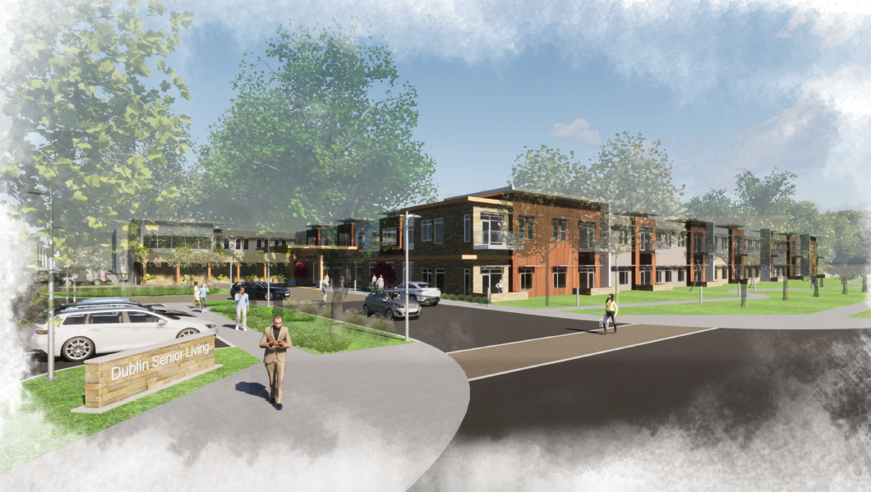
Proposed Project – 3D View
View from Arnold Road looking southeast
Notes:
This here is a 3-D view of the proposed project from Arnold Road looking southeast. You can see this is the main driveway access to the building. The projects architectural style utilizes a contemporary design approach that provides for varied materials and colors and offers residents of the facility exterior balconies located along here.

Slide 8
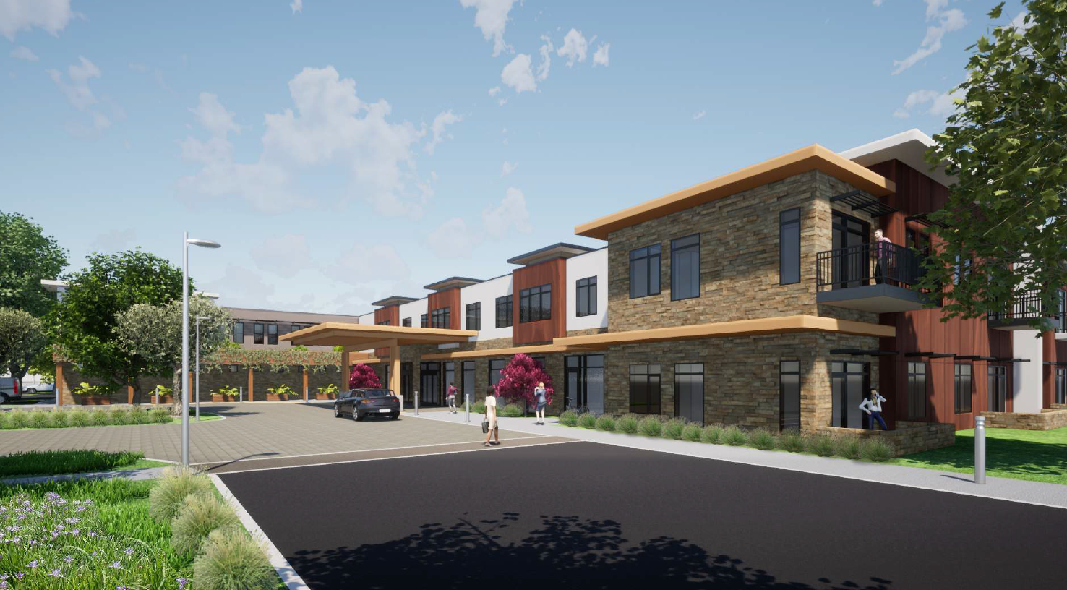
Proposed Project – 3D View
View from project entrance off Arnold Road looking southeast
Notes:
This here is another 3-D view of the project from the driveway entrance off Arnold Road looking southeast. This view provides a better illustration of the building materials and colors that are proposed. Here you can see engineered wood panels, cultured stone, stucco, and metal trim. You’ll notice the project provides for varied roof heights for to break-up the massing.

Slide 9
Proposed Elevations
Notes:
Here is the proposed north elevation. This elevation provides for white/grey stucco, wood panels, metal trim and culture stone here. The building is two story’s with a maximum height of 28 feet.

Slide 10
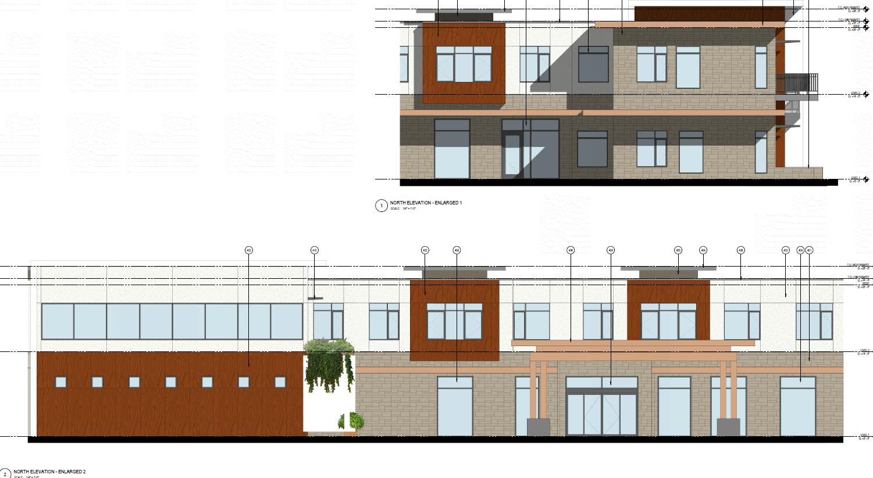
Proposed Elevations
Notes:
Here is a more focused perspective of the north west corner of the building. You can see the variation and textures in building materials being provide.

Slide 11
Proposed Elevations
Notes:
Here is the proposed west elevation. Again using the same materials/colors, this elevation provides balconies for majority of the assisted living residents.

Slide 12
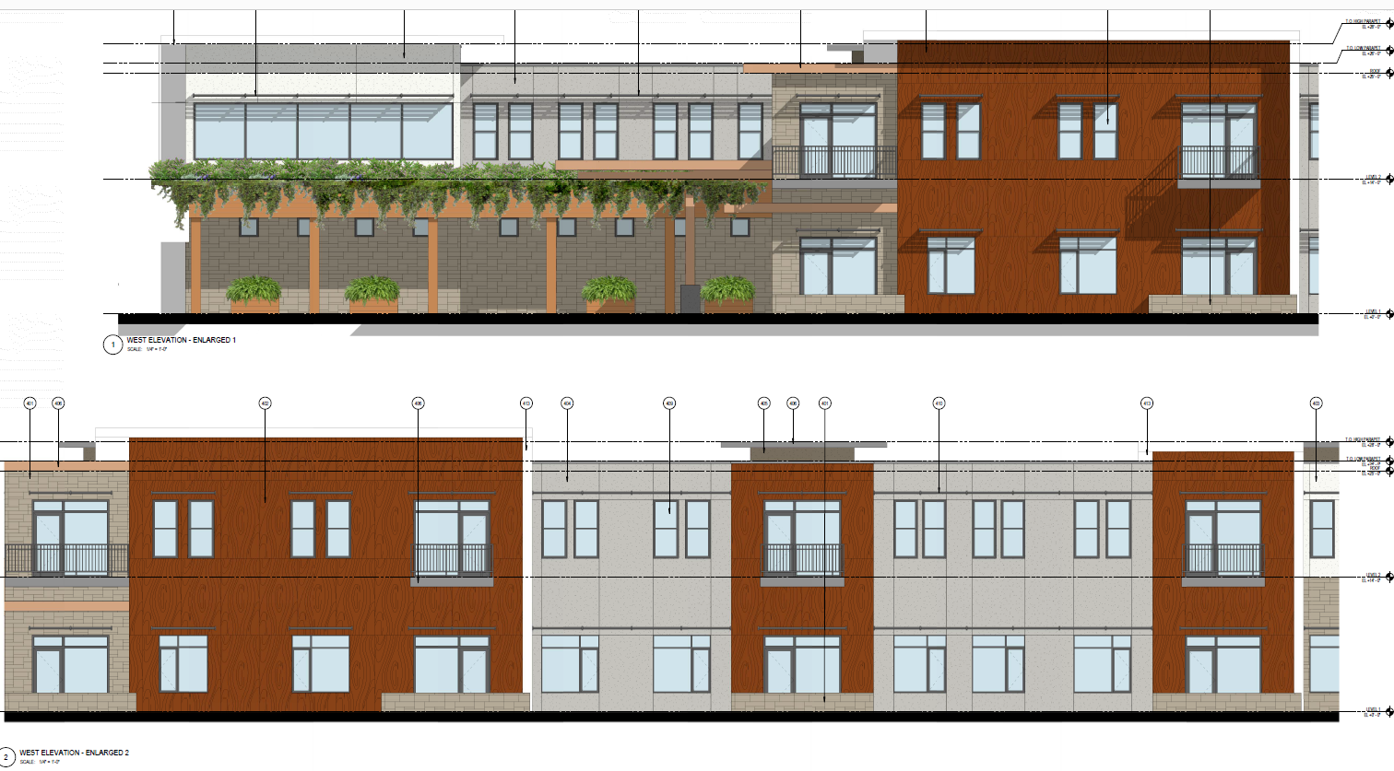
Proposed Elevations
Notes:
Here is a more focused perspective of the most western side of the building, particularly the landscaped trellis and planter boxes that will provide access to the main entrance. The landscaping here helps to soften this elevation.

Slide 13
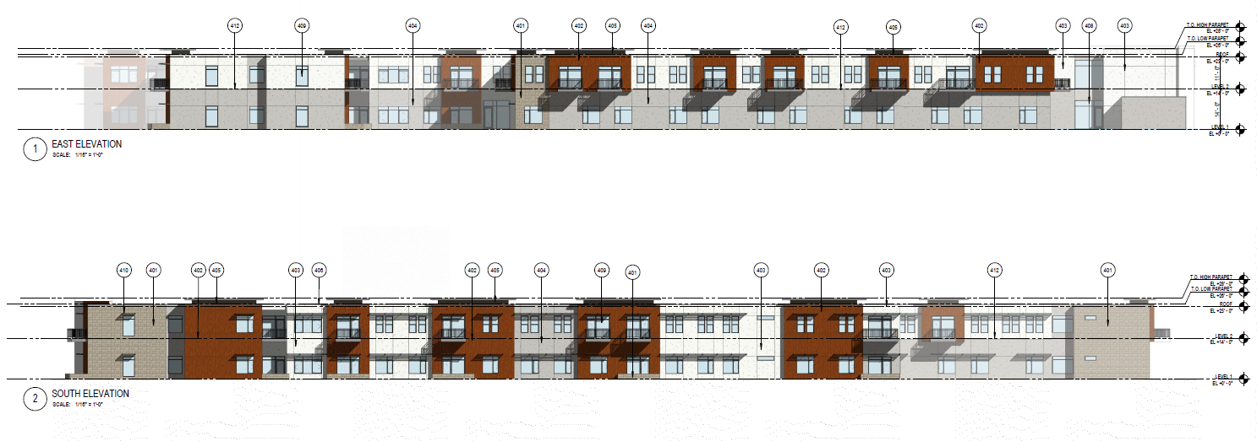
Proposed Elevations
Notes:
Here are the proposed east and south elevations. Again, using the same colors/materials, and varying building heights to break-up the massing of the project.

Slide 14
Questions
Notes:
That concludes my presentation. I would like to thank you for attending our community meeting. I will not open it up for any questions you may have – thank you!

